Slide 1

Insights From Airbnb Analysis From the Pre-COVID Period
Notes:
Objective

Slide 2
AGENDA
Objective
Background
Key findings
Recommendations
Appendix
Data sources
Data methodology
Data model assumptions
Notes:
Objective

Slide 3
OBJECTIVES
Improve strategies to revive the business in the post-COVID period.
Understand key insights from Airbnb NYC business in the pre-COVID period.
Estimate customer preferences for the post-COVID period travel.
Notes:
Objective

Slide 4
BACKGROUND
The COVID-19 pandemic affected Airbnb business due to travel restrictions.
The revenue took the largest hit in NYC in Q2 of 2020.
Now that the travel restrictions are lifted, business should be resumed to recover the losses.
Notes:
Objective

Slide 5
OBJECTIVE OF THE ANALYSIS OF THE AIRBNB NYC DATA
Customer preferences and ratings of Airbnb hosts in New York City were analysed.
The data was analysed to derive key insights about the pre-COVID period.
The insights were used to make decisions for the NYC Airbnb business for travel in the post-COVID period.
Notes:
Objective

Slide 6
DATA PREPARATION AND CLEANING
The data was cleaned of any missing values and outliers.
The data was analysed using simple statistical techniques.
The visualisations were derived using the Plotly tool to understand key inferences from the analysis.
Notes:
Objective

Slide 7
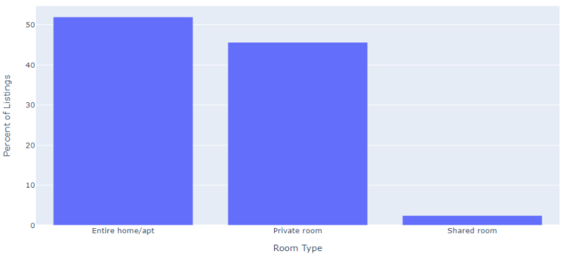
CUSTOMER PREFERENCES OF THE THREE PROPERTY TYPES
The properties of ‘Entire home/apt’ and ‘Private room’ are preferred over shared rooms by Airbnb hosts offering rentals in NYC.
The room types ‘Entire home/apt’ and ‘Private room’ account for a major portion of the listed properties in NYC (around 97.6%).
Shared rooms account for only 2.4% of the total listed properties.
Notes:
Objective

Slide 8
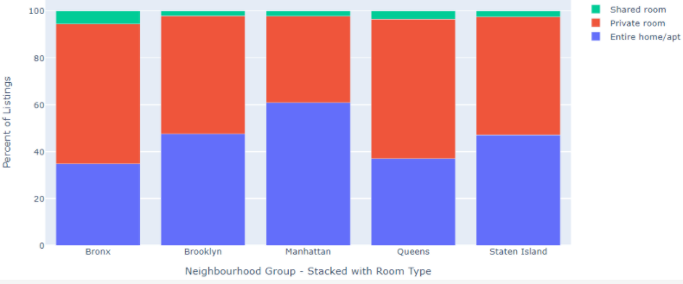
CUSTOMER PREFERENCES OF PROPERTIES IN NYC AREAS
The properties in Manhattan are the most expensive, while those in Bronx are the least expensive.
Manhattan has a 14.7% higher contribution of ‘Entire home/apt’ compared to the overall contribution of ‘Entire home/apt’.
Queens has a 23.2% higher contribution of ‘Private room’ compared to the overall contribution of ‘Private room’.
Notes:
Objective

Slide 9
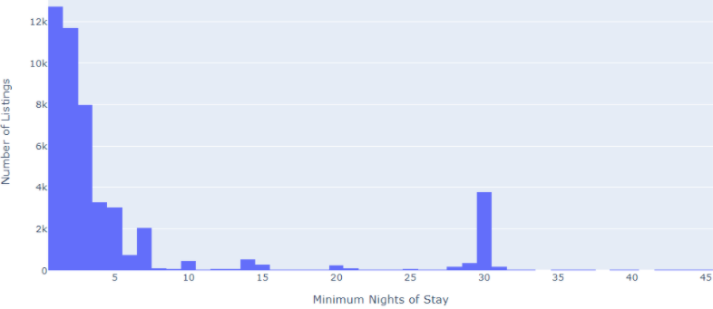
PREFERENCES FOR MINIMUM NIGHTS STAY AND PROPERTY PRICE
The number of listings cross 12k for a minimum stay of fewer than 5 nights and decreases until a spike is observed at a minimum stay of 30 nights.
Properties with lower prices have more reviews, which translates to more bookings for such properties.
Properties with a higher number of minimum nights of stay and higher price have poor reviews.
Notes:
Objective

Slide 10
APPENDIX – DATA ASSUMPTIONS
We assumed that the desired amount of revenue was being generated in the pre-COVID period.
We assumed that the company does not want to expand to new territories in NYC yet.
The company’s strategies are decided upon assuming that travel will increase in the post-COVID period.
Notes:
Objective

